Slide 1

Autify: Automatic Playlist Continuation for Spotify
ECE461 Machine Learning for Data Science and Analytics
Final Project Presentation
Ioanna-Maria Panagou, Ioannis Matskidis

Slide 2
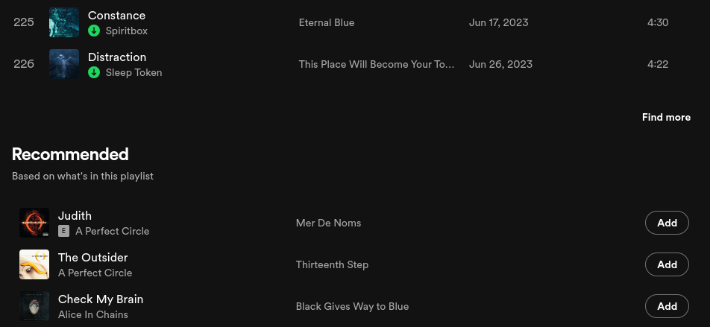
What is APC (Automatic Playlist Continuation)?
Automatic Playlist Continuation (APC) refers to the task of adding one or more tracks to a playlist in a way that fits the same target characteristics of the original playlist
Example

Slide 3
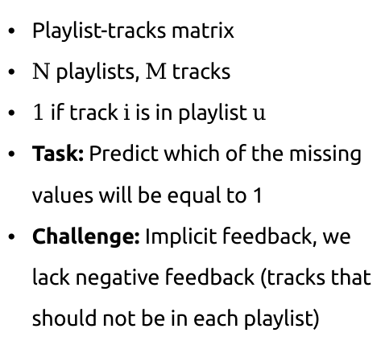


What is APC (Automatic Playlist Continuation)?
$$M$$
Playlist-tracks matrix
$N$ playlists, $M$ tracks
$1$ if track $i$ is in playlist $u$
Task: Predict which of the missing values will be equal to 1
Challenge: Implicit feedback, we lack negative feedback (tracks that should not be in each playlist)
1
1
1
1
1
1
1
1
1
$$N$$
1
1
1
1
1
1
1

Slide 4
Dataset
Spotify Million Playlist (MDP) Dataset
80/10/10 training/validation/testing split
Simulate missing entries for validation and testing dataset by zeroing some entries in the playlist-tracks matrix
Use the SpotifyAPI to extract features for each track (energy, instrumentalness, loudness etc)
{
"name": "musical",
"collaborative": "false",
"pid": 5,
"modified_at": 1493424000,
"num_albums": 7,
"num_tracks": 12,
"num_followers": 1,
"num_edits": 2,
"duration_ms": 2657366,
"num_artists": 6,
"tracks": [
{
"pos": 0,
"artist_name": "Degiheugi",
"track_uri": "spotify:track:7vqa3sDmtEaVJ2gcvxtRID",
"artist_uri": "spotify:artist:3V2paBXEoZIAhfZRJmo2jL",
"track_name": "Finalement",
"album_uri": "spotify:album:2KrRMJ9z7Xjoz1Az4O6UML",
"duration_ms": 166264,
"album_name": "Dancing Chords and Fireflies"
},
// 10 tracks omitted
{
"pos": 11,
"artist_name": "Mo' Horizons",
"track_uri": "spotify:track:7iwx00eBzeSSSy6xfESyWN",
"artist_uri": "spotify:artist:3tuX54dqgS8LsGUvNzgrpP",
"track_name": "Fever 99\u00b0",
"album_uri": "spotify:album:2Fg1t2tyOSGWkVYHlFfXVf",
"duration_ms": 364320,
"album_name": "Come Touch The Sun"
}
],
}

Slide 5
Methods
Matrix Factorization using Alternating-Least Squares
K-Nearest Neighbor for Collaborative Filtering (CF)
Augmenting K-Nearest Neighbor for CF with content-based filtering

Slide 6
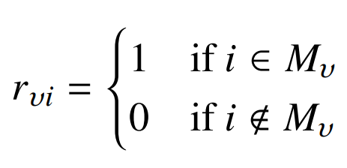
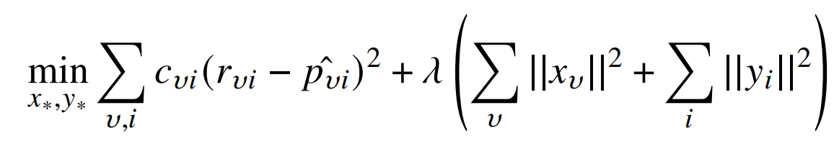

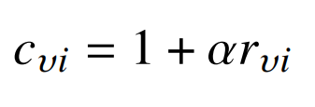






Matrix Factorization using Alternating-Least Squares
M
F
M
Playlist
Latent
Factors
Track Latent Factors
$$y_{i}$$
Playlist-tracks sparse matrix
N
=
N
$$r_{ui}$$
$$x_{u}$$
Goal
$$if i in playlist u$$
$$if i not in playlist u$$
where
$$α: weight for positive samples$$
regularization

Slide 7
Methods
Matrix Factorization using Alternating-Least Squares
K-Nearest Neighbor for Collaborative Filtering (CF)
Augmenting K-Nearest Neighbor for CF with content-based filtering

Slide 8

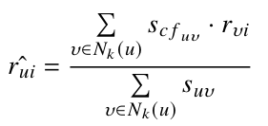

K-Nearest Neighbor for Collaborative Filtering (CF)
Find playlist similarities as
Select K nearest neighbors (playlists) with query playlists
Calculate predicted track relevance i for query playlist u as
Select the tracks with the greatest relevance scores
t1
t2
t3
t4
t5
1
1
1
p1
1
1
p2
1
1
1
1
p3
1
1
p4
Modification: Low-popularity items define similarity better

Slide 9
Methods
Matrix Factorization using Alternating-Least Squares
K-Nearest Neighbor for Collaborative Filtering (CF)
Augmenting K-Nearest Neighbor for CF with content-based filtering

Slide 10



Augmenting K-Nearest Neighbor for CF with content-based filtering
Content-based similarity
$${\hat{f}}_{P}$$
where is a vector consisting of the mean audio features values across all tracks in the playlist P
Redefine similarity as a weighted average between CF and CB similarity

Slide 11
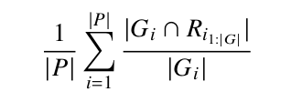
Experiments
For hyperparameter tuning, parameter grid search using validation dataset
Evaluation on testing dataset
R-precision: the number of tracks in the recommendations R that are actually in the groundtruth playlist G, divided by the number of withheld tracks (tracks that are not in the validation/testing set, but are in the groundtruth) averaged across all playlists

Slide 12
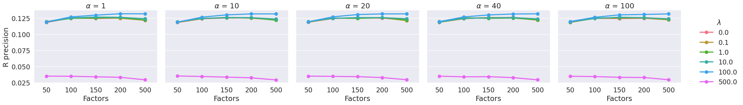
Results - MF w/ ALS
Model is not sensitive to the weight of positive samples $α$
Small number of factors results in underfitting and large number of factors in overfitting
The optimal regularization strength is 100

Slide 13
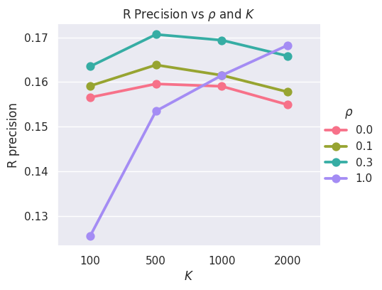
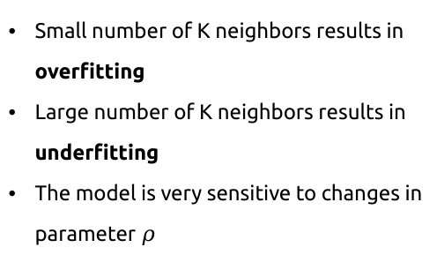
Results - KNN for CF
Small number of K neighbors results in overfitting
Large number of K neighbors results in underfitting
The model is very sensitive to changes in parameter $ρ$

Slide 14
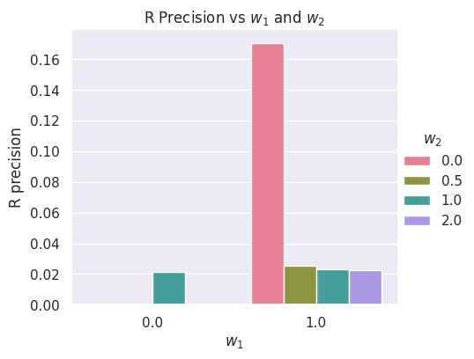
Results - KNN for CF augmented with CB
Content-based filtering yields disappointing results
Dissimilar playlists can contain tracks with similar content or vice-verse, dissimilar tracks can be contained in the same playlist
Features are vague and cannot quantify genre, mood, occasion etc a track can fit into

